Slide 1
Electronic Dictionary Instructions
Open MS PowerPoint
Save your presentation to your 0365 Account in your class folder as:
Ch. ? Electronic Dictionary
Create your Electronic Dictionary
Next, create a Title Slide that states
Electronic Dictionary, Class Name & Your Name
Create a List of Words Slide
Create a slide for each vocabulary word
Define each word
Use each word in a sentence
Add an image that fits the vocabulary word.
Create a Resources Slide
When done save all of your changes.
Send the completed document in an email message to tellsworth@fillmorecsd.org as an attachment.
Subject line: IB - Ch. 1 Electronic Dictionary

Slide 2
Ch. 1 Electronic Dictionary
Business Law
Your Name

Slide 3
List of Ch. 1 Words
Morality
Ethics
Law
Constitution
Common law
Precedent
Statutes
Legislature
Unconstitutional
Administrative law

Slide 4
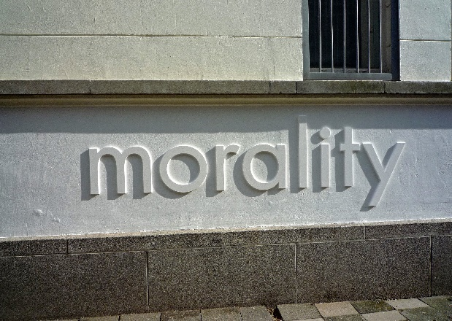
morality
Definition – Values that govern a society’s attitude toward right and wrong.
Use in a sentence – The morality of our present society is very weak.

Slide 5
ethics
Definition –
Use in a sentence –
Add an image -

Slide 6
law
Definition –
Use in a sentence –
Add an image -

Slide 7
constitution
Definition –
Use in a sentence –
Add an image -

Slide 8
Common law
Definition –
Use in a sentence –
Add an image -

Slide 9
precedent
Definition –
Use in a sentence –
Add an image -

Slide 10
statutes
Definition –
Use in a sentence –
Add an image -

Slide 11
legislature
Definition –
Use in a sentence –
Add an image -

Slide 12
unconstitutional
Definition –
Use in a sentence –
Add an image -

Slide 13
Administrative law
Definition –
Use in a sentence –
Add an image -

Slide 14
Resources
Personal and Business Law Textbook
MS Power Point Online Images
Google Images

